Slide 1







IBM CAPSTONE PROJECT
WEEK5 CAPSTONE (ibm.com)
PABLO LIMA
29-07-2023

Slide 2




OUTLINE
Executive Summary
Introduction
Methodology
Results
Visualization – Charts
Dashboard
Discussion
Findings & Implications
Conclusion
Appendix

Slide 3

EXECUTIVE SUMMARY
Point1
Point2
Sub Point 1
Sub Point 2
Sub Point 3
Point3
Point4
Point5

Slide 4

INTRODUCTION
Popular at tech right now
Programming Languages
Databases
Platforms
Webframes
The tomorrow of tech
What programmers desired to learn
The Tech Census
Gender
Age
Country
Scholarship

Slide 5

METHODOLOGY
Data Collection
GitHub job postings
Programming languages annual salaries
Data Wrangling
Data Exploration
Data Cleaning
Data Visualization
IBM Cognos Analytics

Slide 6
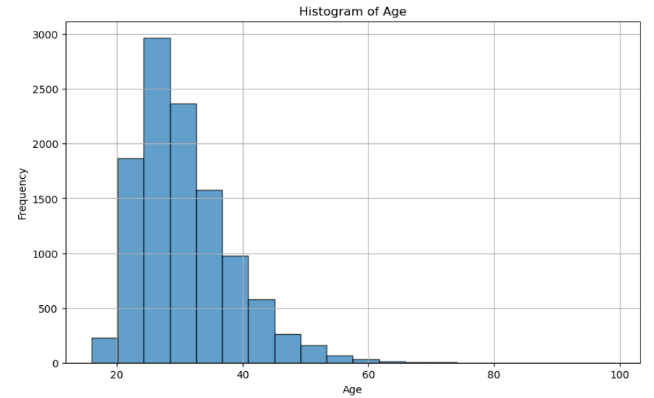
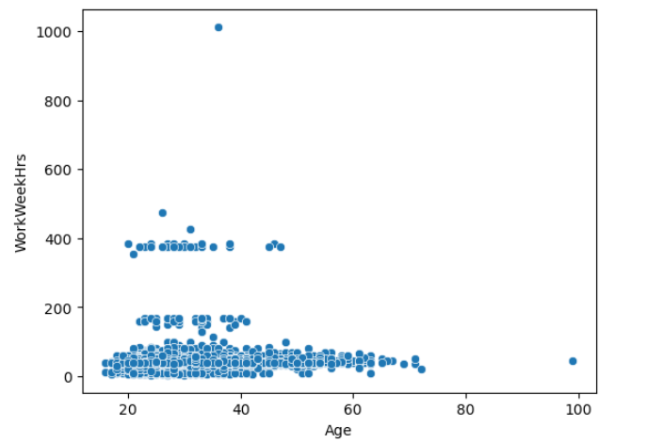
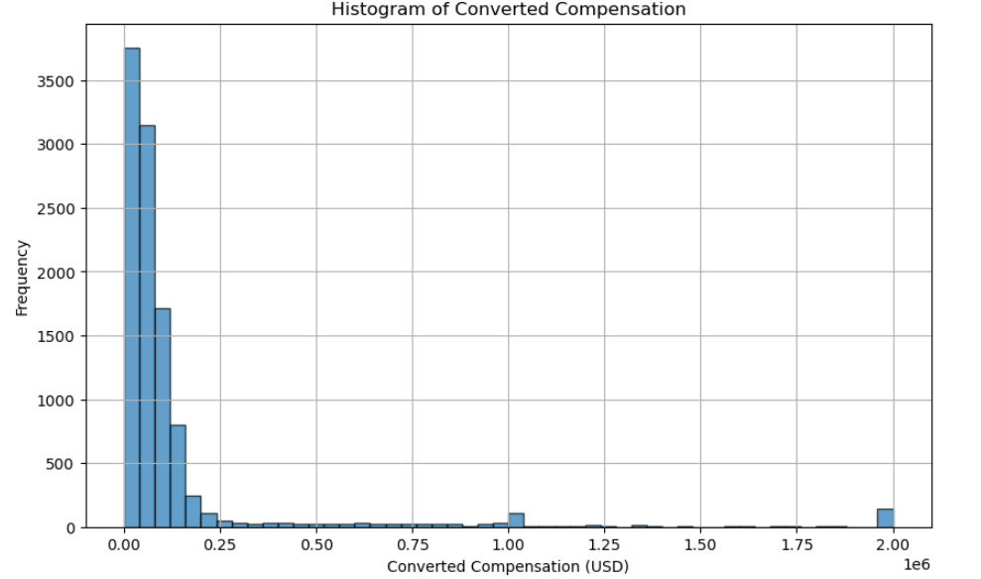
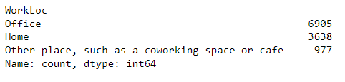
RESULTS

Slide 7
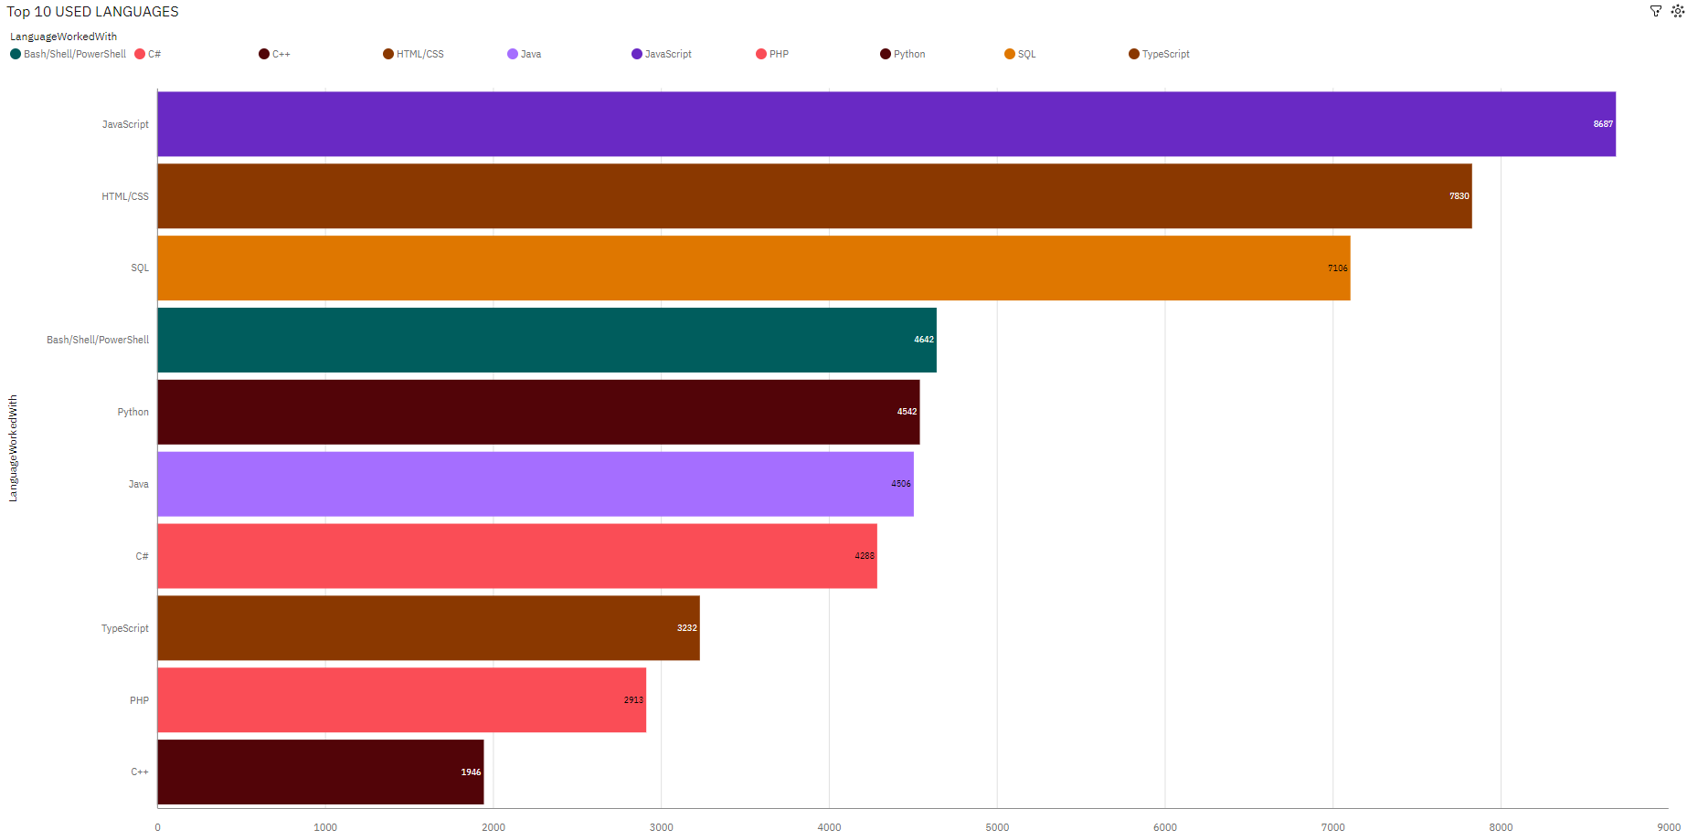
PROGRAMMING LANGUAGE TRENDS TODAY

Slide 8
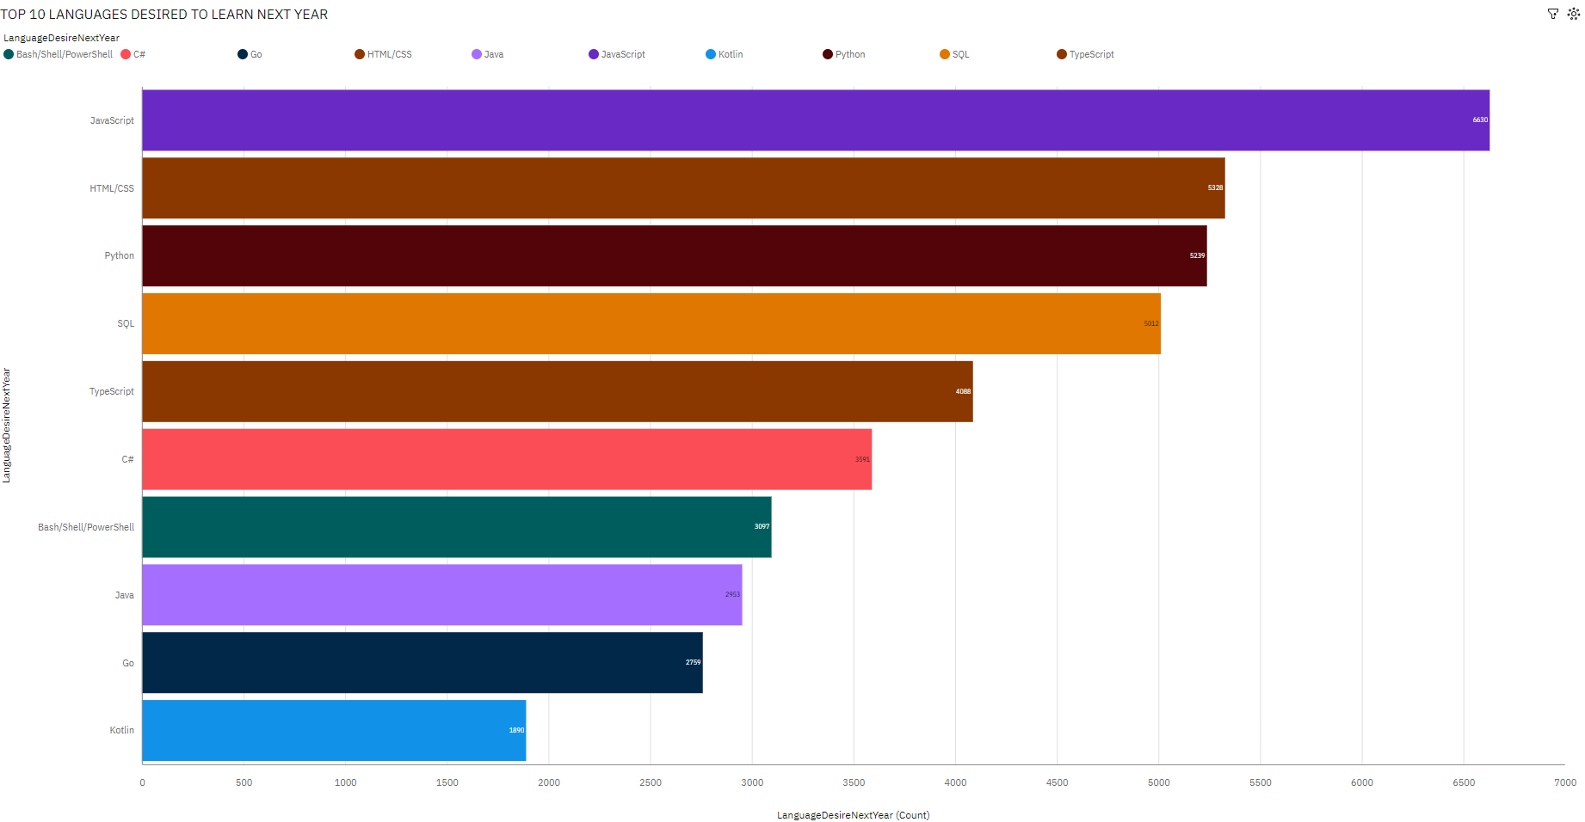
PROGRAMMING LANGUAGE TRENDS FOR THE NEXT YEAR

Slide 9
PROGRAMMING LANGUAGE TRENDS - FINDINGS & IMPLICATIONS
Findings
JavaScript (17.5 %), HTML/CSS (15.8 %), and SQL (14.3 %) are the most frequently occurring categories of LanguageWorkedWith with a combined count of 23,623 items with LanguageWorkedWith values (47.5 % of the total).
JavaScript is the most frequently occurring category of LanguageDesireNextYear with a count of 6630 items with LanguageDesireNextYear values (16.3 % of the total).
Python goes from the 5th most popular right now to 3rd most desired to learn next year
Implications
JavaScript has a high demand for programmers, being interest to them right now and for the next year
Almost 50% of the programmers works with JavaScrpit, HTML/CSS and SQL, proving that is a hot market.
Python is increasing, showing that has a demand to grow for programmers

Slide 10
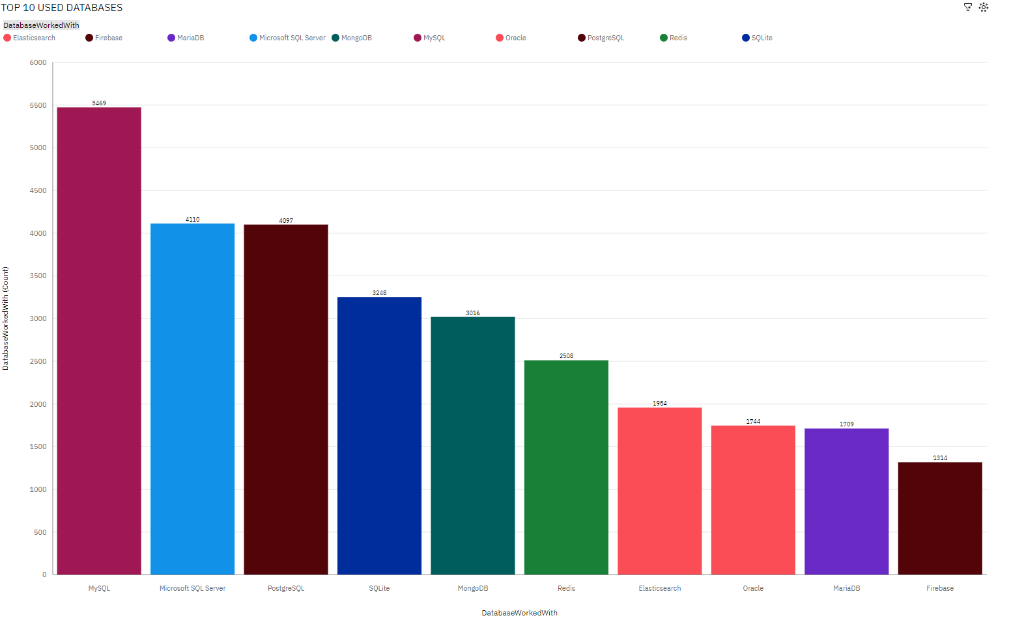
DATABASE TRENDS TODAY

Slide 11
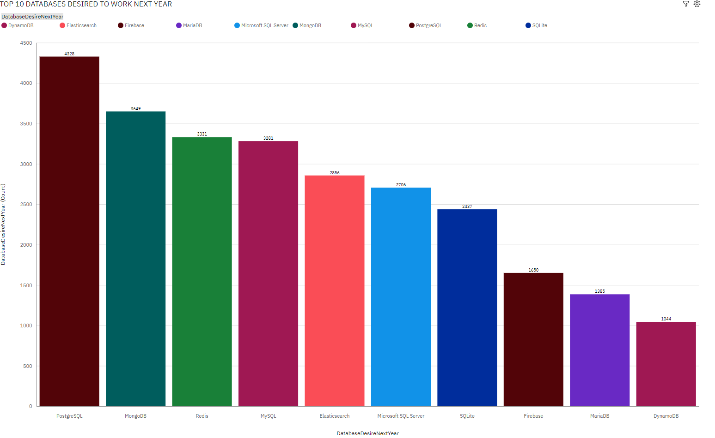
DATABASE TRENDS FOR THE NEXT YEAR

Slide 12
DATABASE TRENDS - FINDINGS & IMPLICATIONS
Findings
PostgreSQL is the most frequently occurring category of DatabaseDesireNextYear with a count of 4328 items with DatabaseDesireNextYear values (16.2 % of the total).
MySQL is the most frequently occurring category of DatabaseWorkedWith with a count of 5469 items with DatabaseWorkedWith values (18.7 % of the total).
While Microsoft SQL Server is the second most popular right now, is the 6th most desired to learn next year
Implications
PostgreSQL has potential to become one of the most popular Databases.
MySQL is the most popular right now, but for the desired next year, goes to 4th, showing that the market is shrinking.
Microsoft SQL Server will have a big decreasing market in the near future

Slide 13

DASHBOARD
* WEEK5 CAPSTONE Dashboard (ibm.com)

Slide 14
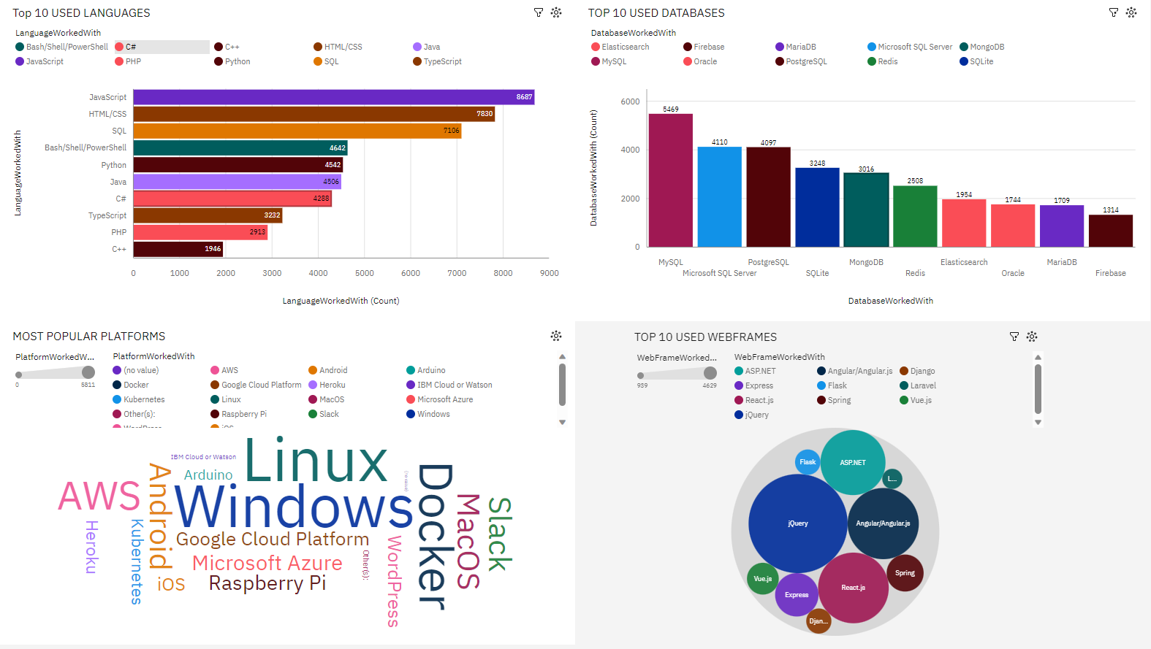
CURRENT TECHNOLOGY USAGE

Slide 15
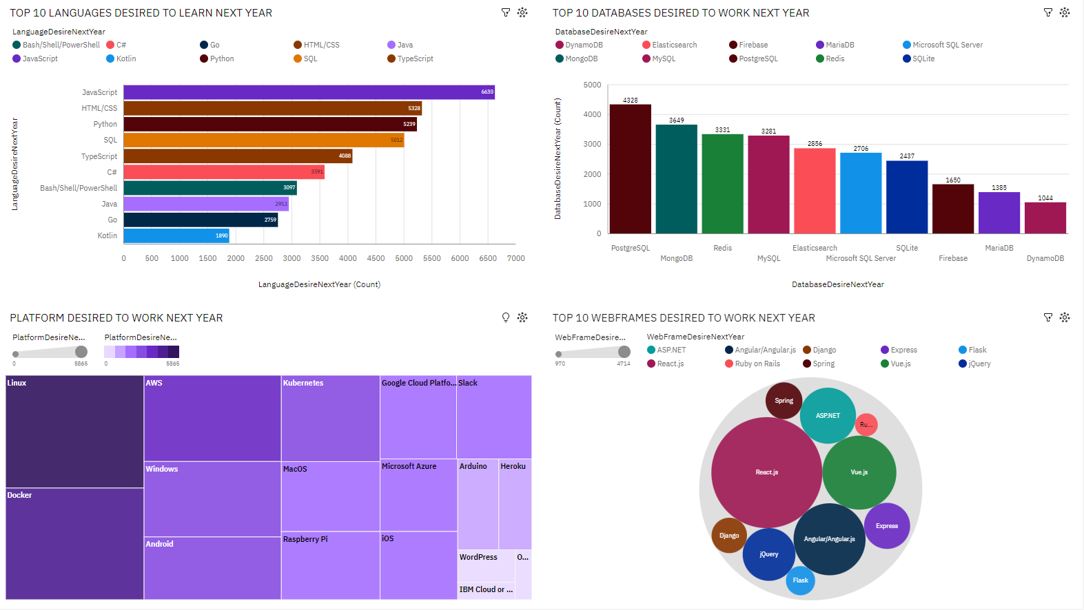
FUTURE TECHNOLOGY TREND

Slide 16
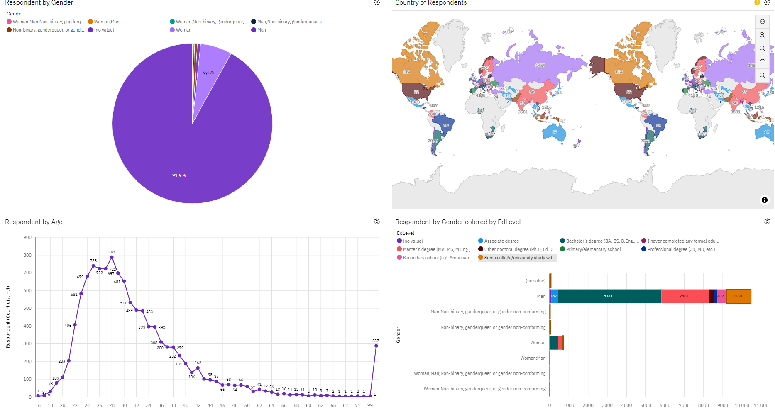
DEMOGRAPHICS

Slide 17
DISCUSSION
How AI affected the market?
Why USA leads in programmers?
Why 91.9% of the programmers are men?

Slide 18
OVERALL FINDINGS & IMPLICATIONS
Findings
EdLevel Bachelor’s degree (BA, BS, B.Eng., etc.) has the highest Respondent at nearly 6 thousand, out of which Gender Man contributed the most at nearly 5500.
Country Jamaica has the lowest average Age at 21.0, followed by Somalia at 22.0.
Gender Man Respondent from Country United States is 2805, whereas Woman is only 253.
Implications
Programmers usually goes to college and get a degree. So the market has a high Education level.
Jamaican programmers are young, showing that is a recent market in the country
The market is predominantly male.

Slide 19

CONCLUSION
The market of popular technologies changes very fast.
The AI will have a big impact in where the market goes.
Programmers needs to be very versatile, always learning trending technologies.
While USA has the most programmers, the programmers are distributed in a lot of countries.

Slide 20
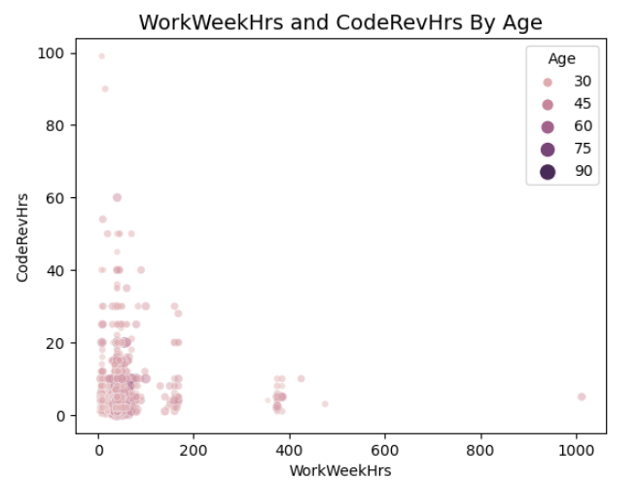
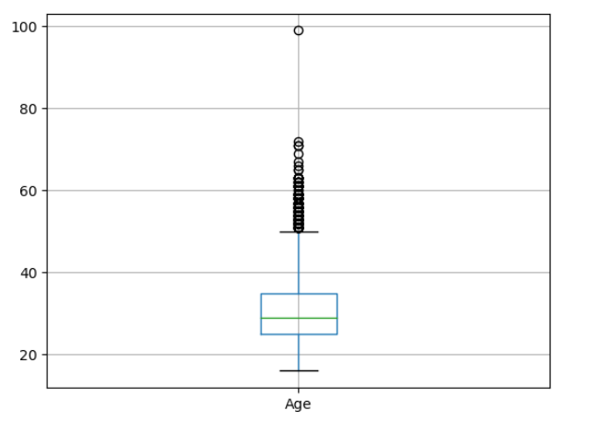
APPENDIX – PROGRAMMERS AGE/CODEREV

Slide 21
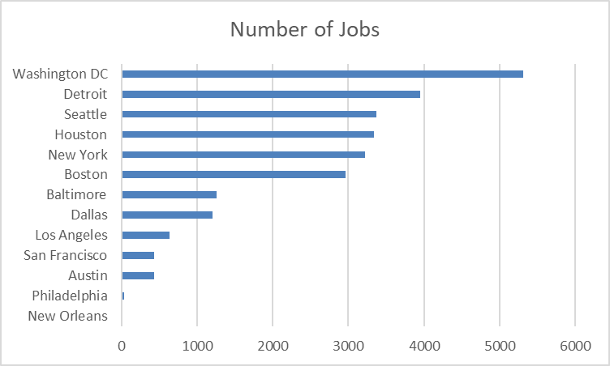
JOB POSTINGS

Slide 22
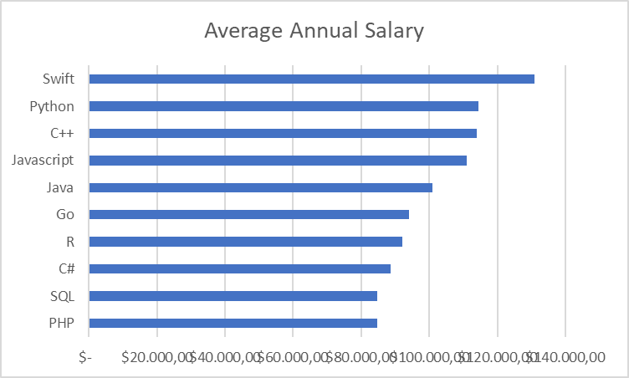
POPULAR LANGUAGES

